Slide 1
ITCS 6160 - Group 8
Dhruvik Patel,
Gowri Alwarsamy,
Mahitha Garikipati,
Sakshi Kaondal

Slide 2
CAMPUS EATS
Introduction
Enhancements
EERD
Views
Procedures

Slide 3
INTRODUCTION
The idea of this project is to understand and enhance the campus eats database, which is a food delivery service application developed by team Maverick
This database is enhanced to provide rating system for both restaurants and delivery drivers.
With the enhancement of this existing campus eats database, food delivery customers will have the option to rate both the restaurant and the food delivery person.
With the enhancement of this existing test database, food delivery customers will have the option to rate both the restaurant and the food delivery person.
Every time a customer places an order for delivery, they will have an opportunity to rate the restaurant and the driver for that order after the food has been delivered.
The ratings are made on the scale of 1 to 1 being the least and 5 being the highest. Similarly, food delivery customers will also have the option to upload picture and to add comments

Slide 4
Enhancements
For the existing Database, few tables are added for the database enhancement.
Items table :
This table keeps track of all the items with regard to a restaurant
Order_items table
This table keeps track of all the items a customer ordered with respect to each order
Ratings table
This table keeps track of restaurant and delivery ratings as well as feedback that a customer provided on each single order.

Slide 5
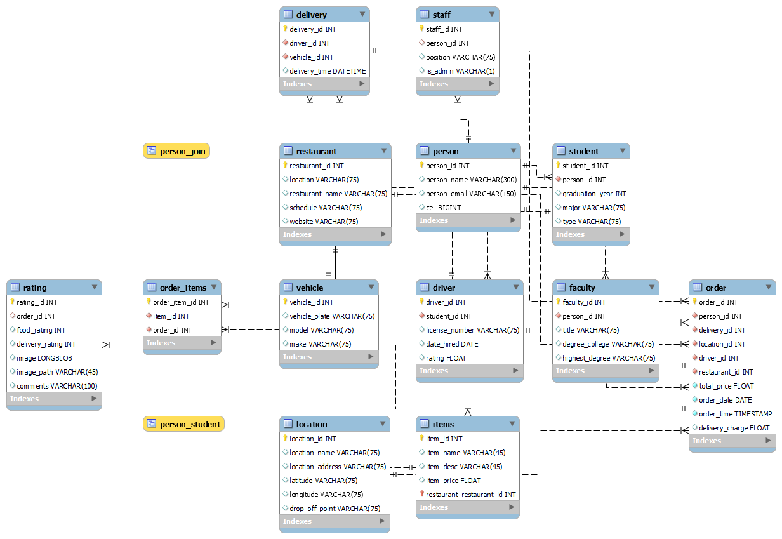

Slide 6
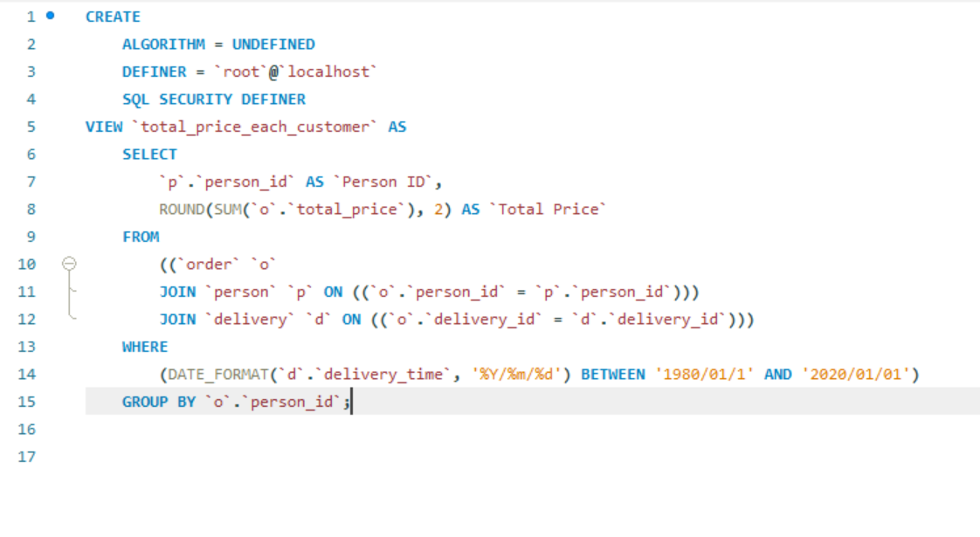
View 1: Total Price of Orders
In order to get a total price of orders for each customer, a view has been created
select * from total_price_each_customer;

Slide 7
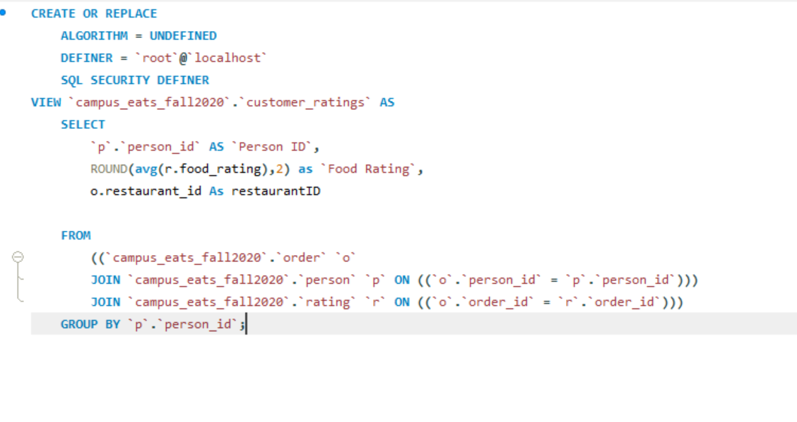
View 2: Average Rating for Restaurant
A view is created to display all the ratings of a customer on an average for each restaurant
select * from customer_ratings;

Slide 8
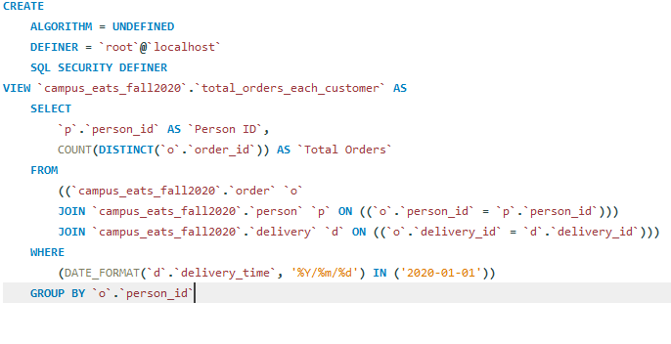
View 3
In order to get the total number of orders per customer on a specified date.
select * from total_orders_each_customer where delivery_date ="1986-03-09 13:02:10";

Slide 9
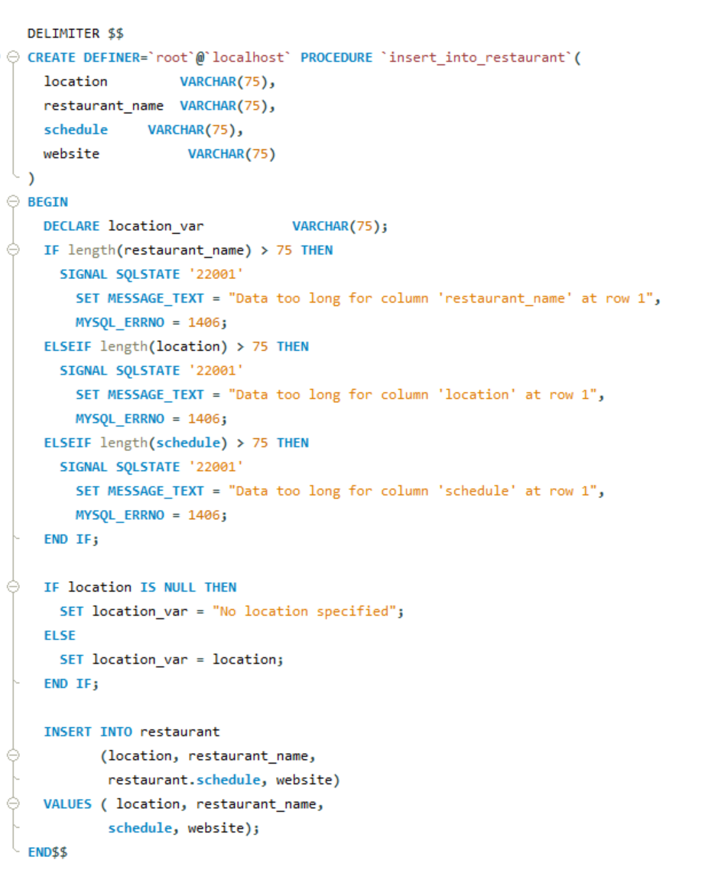
Procedure 1
Procedure to add new restaurants
CALL insert_into_restaurant('Charlotte', 'chartwells', '08AM-09PM', 'chartwellscatering@uncc.edu');

Slide 10
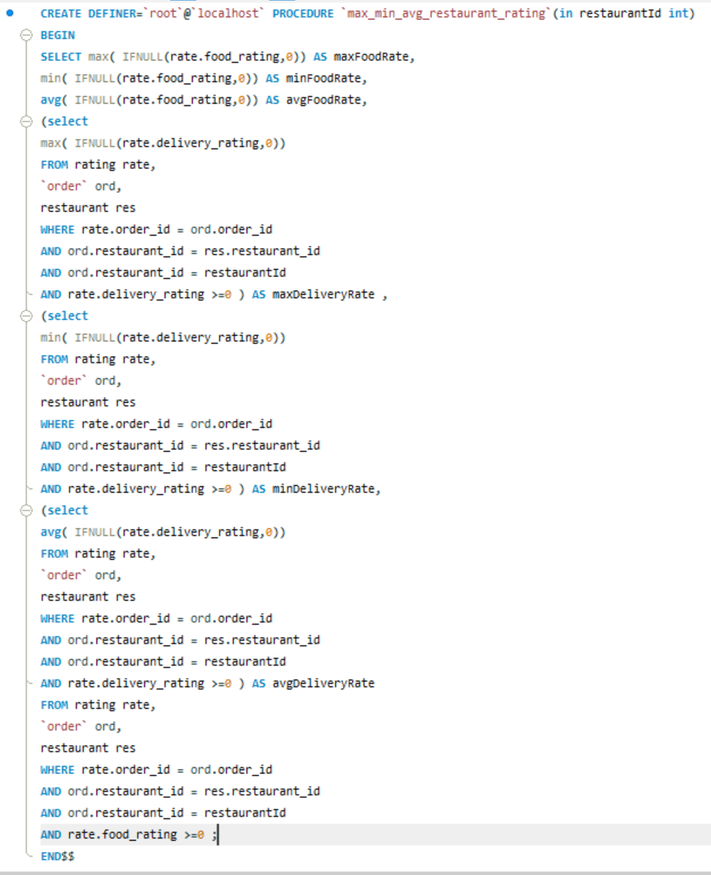
Procedure 2
Retrieve maximum, minimum, average food and delivery ratings for all orders of a restaurant given restaurant id
call max_min_avg_restaurant_rating(1);
Since there are too many calculations (max,min,avg) - indexes have been created for better performance and query optimization.
create index ratingVal ON rating(rating_id,food_rating,delivery_rating);

Slide 11
DEMO Of Views & Procedures

Slide 12

Thank you!
Github link - https://github.com/mahithagarikipati/CampusEats

